Slide 1
Visual Studio 2013 Update 4 (RTW)
Robert Green
Developer Evangelist, DX
@rogreen_ms | blogs.msdn.com/b/robertgreen/
Dmitry Lyalin
Product Manager, Visual Studio
@lyalindotcom | www.lyalin.com

Slide 2
Today’s Agenda
Introduction
What’s new today?
What’s new in Visual Studio 2013 Update 4 (RTW)

Slide 3
Today’s Agenda
Demos
What’s new in Team Foundation Server with guest Aaron Bjork
The new GPU Usage tooling with guest Rong Lu

Slide 4
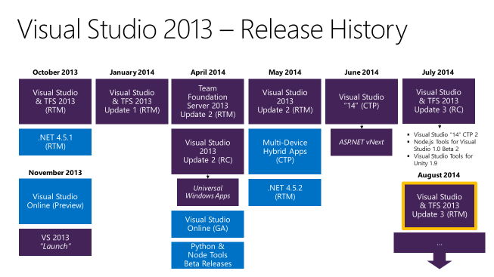
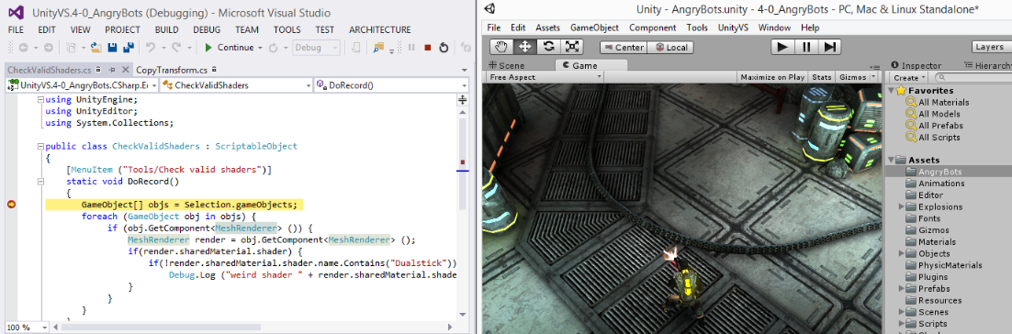
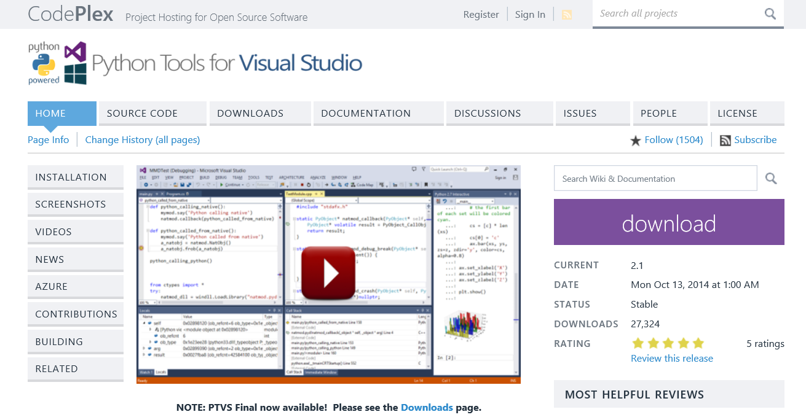
August 4th, 2014
Visual Studio 2013 Update 3
August, 2014
Python Tools for Visual Studio 2.1 (RC)
Visual Studio “14” CTP 3
September, 2014
Visual Studio 2013 Update 4 CTP 1 & 2
Visual Studio Tools for Unity 1.9.1
Team Explorer Everywhere Update 2
October, 2014
Python Tools for Visual Studio 2.1 (RTW)
Visual Studio “14” CTP 4
Visual Studio Tools for Unity 1.9.2
Notes:
Visual Studio 2013 Update 4 RC now Available – Oct 16th 2014
http://blogs.msdn.com/b/visualstudio/archive/2014/10/16/visual-studio-2013-update-4-rc-now-available.aspx
Python Tools 2.1 for Visual Studio – Oct 15th, 2014
http://blogs.msdn.com/b/visualstudio/archive/2014/10/15/python-tools-2-1-for-visual-studio.aspx
Visual Studio “14” CTP 4 - Oct 6th, 2014
http://blogs.msdn.com/b/visualstudio/archive/2014/10/06/visual-studio-14-ctp-4-and-typescript-1-1-ctp-released.aspx
Also released:
TypeScript 1.1 CTP
Visual Studio 2013 Update 4 CTP 2 (And More) Available – Sept 22nd, 2014
http://blogs.msdn.com/b/visualstudio/archive/2014/09/22/visual-studio-2013-update-4-ctp-2-now-available.aspx
Also released:
Visual Studio Tools for Unity 1.9.1
Team Explorer Everywhere 2013 Update 2
Visual Studio 2013 Update 4 CTP 1 Ready to Download – Sept 3rd, 2014
http://blogs.msdn.com/b/visualstudio/archive/2014/09/03/visual-studio-2013-update-4-ctp-1-ready-to-download.aspx
Visual Studio “14” CTP 3 Released – Aug 18th, 2014
http://blogs.msdn.com/b/visualstudio/archive/2014/08/18/visual-studio-14-ctp-3-released.aspx
Python Tools for Visual Studio 2.1 RC – Aug 12th, 2014
http://blogs.msdn.com/b/visualstudio/archive/2014/08/12/python-tools-for-visual-studio-2-1-rc.aspx

Slide 5
November 12th, 2014
Visual Studio 2013
Update 4 (RTW)
Visual Studio 2015 (Preview)
.NET 2015
ASP.NET 5
Visual Studio Community 2013
Azure SDK 2.5 (RTW)
Notes:
Details:
Visual Studio 2013 Update 4
Visual Studio Community 2013 with Update 4
Azure SDK 2.5, with cloud diagnostics, HDInsight tooling and new features for DevOps scenarios
Visual Studio 2015 Preview, formerly known as Visual Studio “14”
Includes .NET 2015 Preview, ASP.NET 5 Preview

Slide 6
Visual Studio 2013 – Update 4 (RTW)
Visual Studio 2013
Foundation Server 2013
Web & Azure Development
Application Lifecycle Management
JSON Editor Improvements
HTML & CSS Editor Improvements
Lightweight Charting
Test Case Management
Updated WebJobs Tooling
Updated Template Packages
Git Pull Requests
Work Item Tracking Improvements
C++
App Insights
Release Management
GPU Usage Debugging Tool
Faster Solution Browsing
Notes:
What’s new in ASP.NET in Update 4:
http://blogs.msdn.com/b/webdev/archive/2014/10/16/announcing-new-web-features-in-visual-studio-2013-update-4-rc.aspx
GPU Usage Debugging Tool:
“A new GPU Usage tool in the Performance and Diagnostics hub helps you determine whether the CPU or the GPU is the performance bottleneck. This tool lets you collect and analyze GPU usage data for DirectX applications.”

Slide 7
Blogs & Release Notes What’s new for Update 4 in ASP.NET Blog Post Visual Studio 2013 Update 4 Release Notes

Slide 8
Demos (1) Application Lifecycle Management (2) GPU Usage Diagnostics, Azure

Slide 9
To learn more about Update 4 visit
http://www.visualstudio.com/news
Robert Green
@rogreen_ms | blogs.msdn.com/b/robertgreen/
Dmitry Lyalin
@lyalindotcom | www.lyalin.com

